Slide 1
Email and Workplace Efficiency
How to save yourself time (and stress!) at work
By: Brynne Hamer

Slide 2
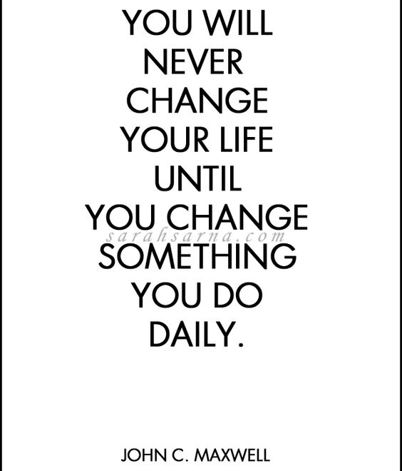

Slide 3
What you’ll learn…
“Email Inbox Zero”
Daily and weekly task organization
Tools, tips, and tricks for staying productive and organized
How to work smarter

Slide 4
“Email Inbox Zero”
How many people feel overwhelmed by email?
Why is your email inbox overwhelming?

Slide 5
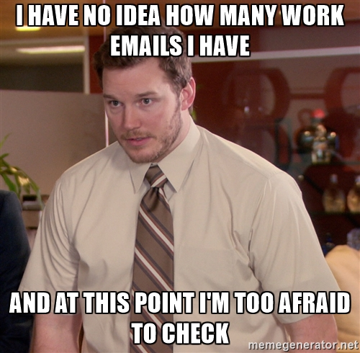

Slide 6
Tips and Tricks

Slide 7
Mark all emails as “Read”
This
Eases anxiety about unread emails
Everything in inbox still needs to be addressed
To this

Slide 8
Determine how often you check your email
Two screens up – 1 with email?
Taskbar popups?
Dings?
3x daily (morning/lunch/end of day)?

Slide 9
Folder creation
Categorize emails
Type of email
Sort by priority
Sort by sender
Use sub-folders
Too many folders vs. not enough
1x per week/month, clean out email folders

Slide 10
Utilize task/reminders
Flag each email for follow-up at a date determined by you
Sorts emails by priority
Can view tasks in same window as email

Slide 11
Miscellaneous Tips & Tricks
“Respond, Mark or Delete”
Sorting emails by type (messages, meeting invites, etc.)
Start from the bottom or sort by time/date
Use “Clean-Up” button to clear out repeat emails
Use “Rules” to sort emails into folders based on subject or sender
CC yourself on emails
Unsubscribe from email lists

Slide 12
The end result ☺

Slide 13
Tools to Use for Daily & Weekly Organization

Slide 14
Personalization

Slide 15
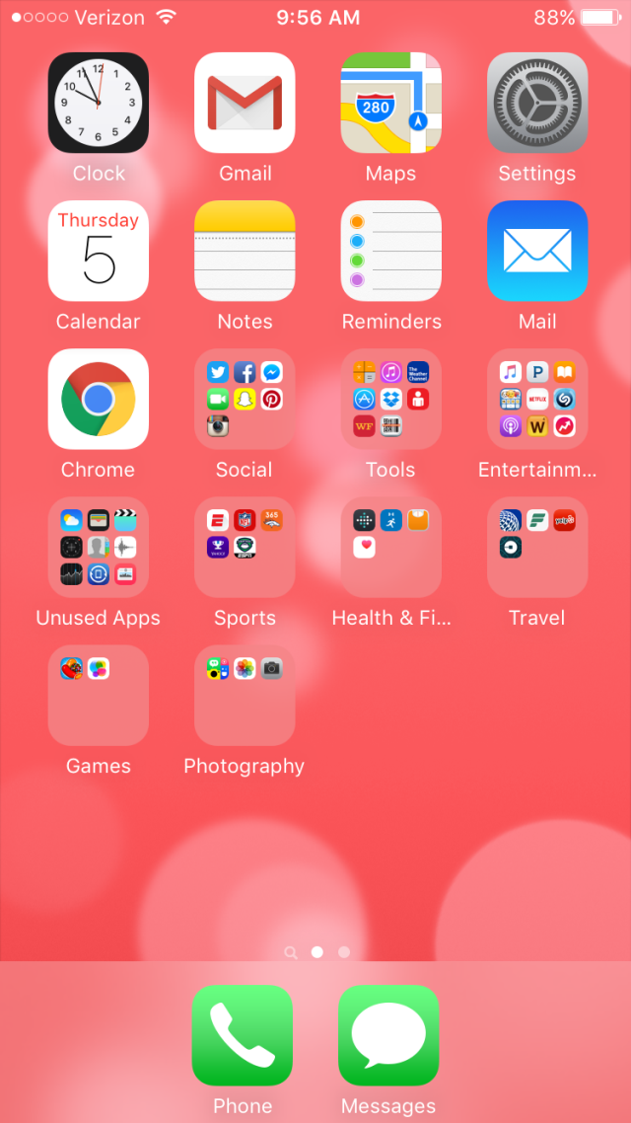
Smart Phone Apps
Mail feature
Outlook App
Calendar
Reminders
Notes/Memos

Slide 16
Utilizing Outlook Calendar
Block off time on calendar for “to-do” items
Utilize notes field in event for to-do tasks

Slide 17
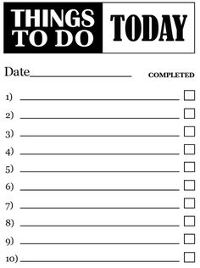
To-Do Lists
Be realistic
Prioritize
Must, should, want
Filter and sort by type of task
Set a time limit and deadline
Set aside time to tackle items
Electronic or paper
Work towards 3 to-do items per day
Rewrite your list
Write list the night before

Slide 18
Increasing Productivity
Take breaks
“Treat yo’self”
Delegate
Accomplish unpleasant/most challenging tasks first
Take time to get organized
Utilize internet/books

Slide 19
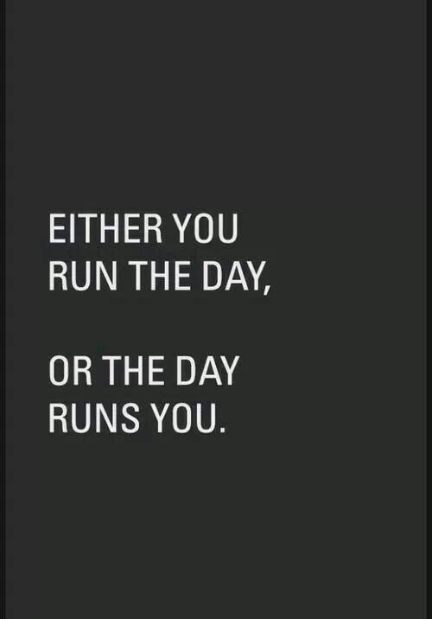

Slide 20
Questions?
Email me! bthrashe@uccs.edu

